Slide 1

TRAVELLING SALESMAN PROBLEM:
Using Genetic Algorithm

Slide 2
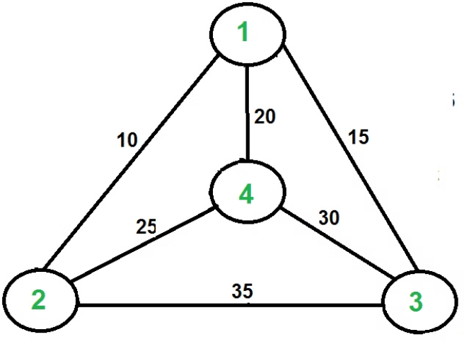
What is the Travelling Salesman Problem (TSP)?
1
Optimization Challenge
2
Real-World Applications
3
NP-Hard Problem
TSP is classified as an NP-Hard problem, making it computationally challenging.
TSP involves finding the shortest route to visit a set of locations exactly once.
Commonly applied in GPS navigation systems and circuit board drilling.

Slide 3
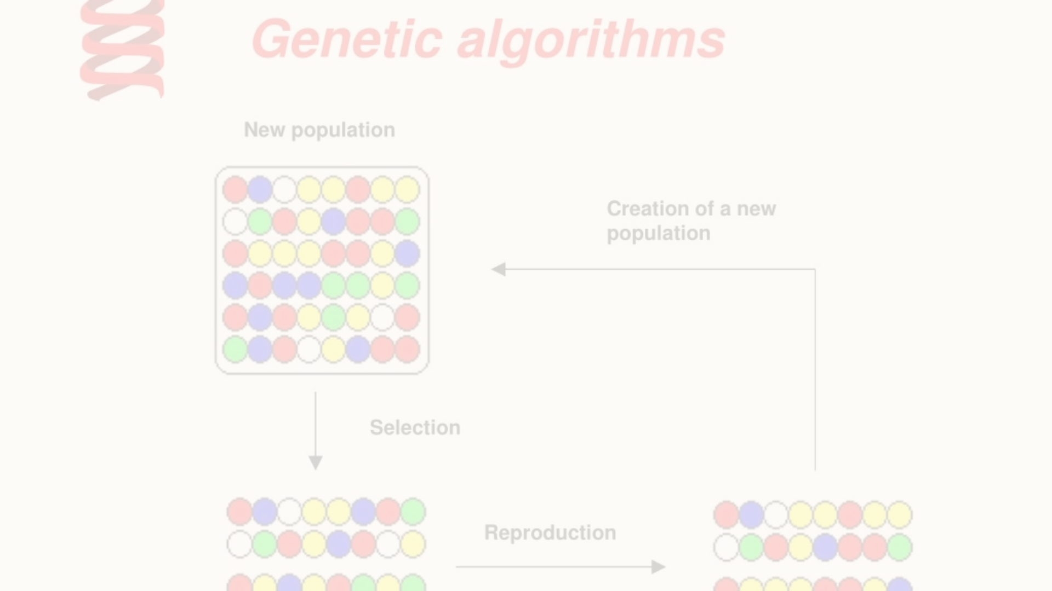
Understanding Genetic Algorithm (GA)
Mimics Natural Selection
Population-Based Approach
Crossbreeding Operations
GA is inspired by biological evolution to generate high-quality solutions.
Utilizes a population of candidate solutions to evolve towards an optimal tour.
Employs crossover and mutation operators to enhance solution diversity.

Slide 4
Applying GA to TSP
Initial Population
Fitness Evaluation
Genetic Operators
Randomly generate a population of potential tours for the TSP.
Calculate the fitness of each tour based on the total distance traveled.
Apply genetic operations to create new tours and improve the population.

Slide 5




Advantages of using GA for TSP
Global Optimum
Fitness Landscapes
Parallelism
Capable of finding near-optimal solutions for large TSP instances.
Effectively navigates complex fitness landscapes with multiple local minima.
Supports parallel execution, speeding up the search for the optimal tour.

Slide 6
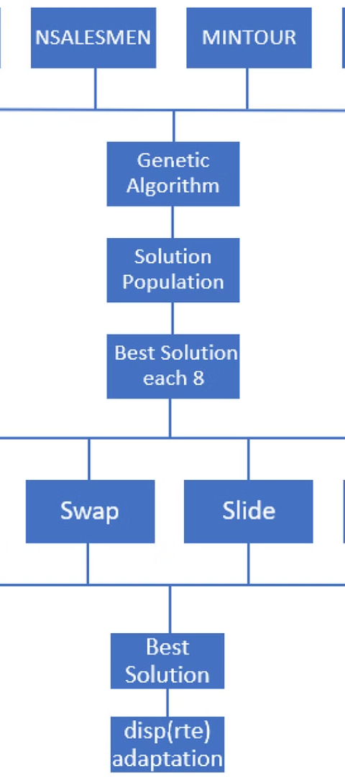
Challenges in implementing GA for TSP
1
Parameter Tuning
Adjusting mutation and crossover rates for different problem instances.
2
Convergence Speed
Balancing exploration and exploitation to reach the optimal solution efficiently.
3
Computational Complexity
Dealing with high computational requirements for large-scale TSP instances.

Slide 7
SOURCE CODE
import java.util.ArrayList;
import java.util.Collections;
import java.util.Random;
public class TSP {
private static final int CITY_COUNT = 5;
private static final int POPULATION_SIZE = 20;
private static final int GENERATIONS = 50;
private static final double MUTATION_RATE = 0.1;
private static final Random random = new Random();
public static void main(String[] args) {
ArrayList<ArrayList<Integer>> population = initializePopulation(POPULATION_SIZE);
for (int generation = 0; generation < GENERATIONS; generation++) {
ArrayList<ArrayList<Integer>> newGeneration = new ArrayList<>();
while (newGeneration.size() < POPULATION_SIZE) {
// Selection (simply select random individuals for crossover)
ArrayList<Integer> parent1 = population.get(random.nextInt(population.size()));
ArrayList<Integer> parent2 = population.get(random.nextInt(population.size()));
// Crossover
ArrayList<Integer> child = crossover(parent1, parent2);
// Mutation
mutate(child, MUTATION_RATE);
newGeneration.add(child);
}
population = newGeneration;
// Optionally, print best fitness of the generation
System.out.println("Generation " + generation + ": Best Distance = " + calculateDistance(population.get(0)));
}
}
private static ArrayList<ArrayList<Integer>> initializePopulation(int size) {
ArrayList<ArrayList<Integer>> population = new ArrayList<>();
ArrayList<Integer> initialPath = new ArrayList<>();
for (int i = 0; i < CITY_COUNT; i++) {
initialPath.add(i);
}
for (int i = 0; i < size; i++) {
ArrayList<Integer> newPath = new ArrayList<>(initialPath);
Collections.shuffle(newPath);
population.add(newPath);
}
return population;
}
private static ArrayList<Integer> crossover(ArrayList<Integer> parent1, ArrayList<Integer> parent2) {
// Simple one-point crossover
int crossoverPoint = random.nextInt(CITY_COUNT);
ArrayList<Integer> child = new ArrayList<>(parent1.subList(0, crossoverPoint));
parent2.forEach(city -> {
if (!child.contains(city)) {
child.add(city);
}
});
return child;
}
private static void mutate(ArrayList<Integer> path, double mutationRate) {
// Simple swap mutation
if (random.nextDouble() < mutationRate) {
int index1 = random.nextInt(path.size());
int index2 = random.nextInt(path.size());
Collections.swap(path, index1, index2);
}
}
private static int calculateDistance(ArrayList<Integer> path) {
// Simplified distance calculation: each step has a distance of 1
// This is a placeholder. In a real scenario, you would calculate the actual distances between cities.
return path.size(); // Simplification for demonstration purposes
}
}

Slide 8
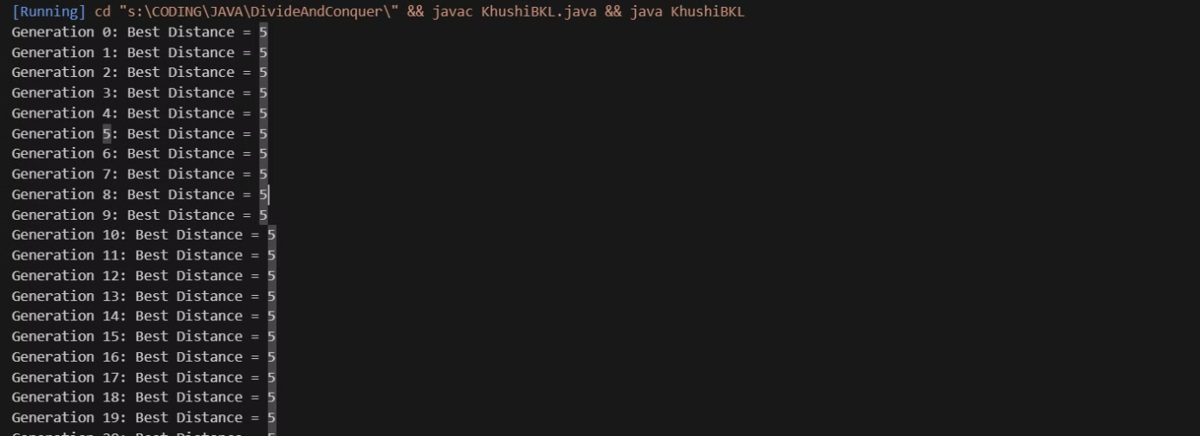
OUTPUT

Slide 9
Conclusion and future scope
Reflection
Summarize the impact and effectiveness of GA for TSP.
Innovation
Explore potential improvements and extensions for TSP optimization.
Integration
Discuss the integration of GA with emerging technologies for enhanced TSP solutions.

Slide 10
THANK YOU
Kamya Yadav (RA2211027010039)
Apoorva Nayak(RA2211027010054)
Manas Tewari(RA2211027010062)

